Slide 1
An Automotive Application of the Organic Rankine Cycle for Power Generation Using Recovered Waste Heat
Glenn Clapp
Masters project collaboration between
Grand Valley State University & GHSP

Slide 2
Outline
Waste heat recovery
Sources
Recovery techniques
Technical hurdles
Thermodynamic cycles
Rankine cycle
Organic Rankine cycle
Kalina cycle
Automotive application
Special design considerations
Heat sources
Selection process
Iterative design
Cycle parameters
Design space
Mathematical modelling
Optimization
Results
Design specifications
Assumptions
Discussion
Conclusion

Slide 3
Outline
Waste heat recovery
Sources
Recovery techniques
Technical hurdles
Thermodynamic cycles
Rankine cycle
Organic Rankine cycle
Kalina cycle
Automotive application
Special design considerations
Heat sources
Selection process
Iterative design
Cycle parameters
Design space
Mathematical modelling
Optimization
Results
Design specifications
Assumptions
Discussion
Conclusion

Slide 4
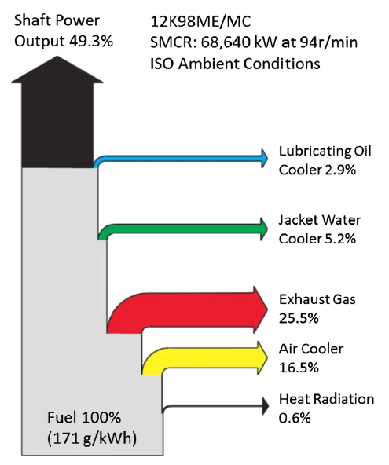
Waste heat recovery source
This diagram shows a common breakdown of waste heat from an engine. Note that less than half of the power originally contained in the fuel produces useful work.
Automotive applications typically convert even lower percentages of power from the energy in fuel into useful work.

Slide 5
Waste heat recovery source
The remaining energy fractions are considered waste heat. The energy from the fuel is converted into heat which is managed by vehicle systems, or escapes into the vehicle’s environment.
It is the goal of this project to harness this waste heat energy to increase the percentage of energy from fuel that does useful work.

Slide 6
Outline
Waste heat recovery
Sources
Recovery techniques
Technical hurdles
Thermodynamic cycles
Rankine cycle
Organic Rankine cycle
Kalina cycle
Automotive application
Special design considerations
Heat sources
Selection process
Iterative design
Cycle parameters
Design space
Mathematical modelling
Optimization
Results
Design specifications
Assumptions
Discussion
Conclusion

Slide 7
Waste heat recovery techniques
Cogeneration
Kinetic energy recovery
Electricity generation

Slide 8
Waste heat recovery techniques
Cogeneration:
Cogeneration is also referred to a combined heat and power (CHP). In a process that meets this description, electricity and useful heat are generated at the same time.
This is the most efficient and technically simple method of harvesting waste heat. The process is simply designed so that the heat generated while generating power is directly useful for some other process on site. It is essentially no longer waste.

Slide 9
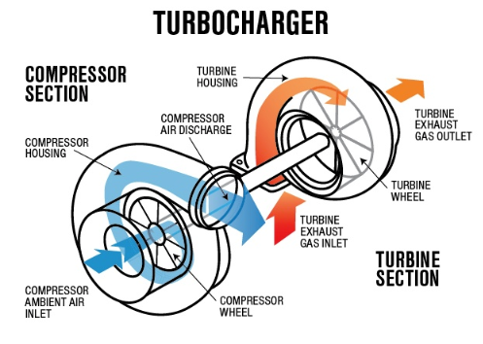
Waste heat recovery techniques
Kinetic energy recovery:
One example of kinetic energy recovery is that of the “turbocharger” which is driven by the exhaust gases from the engine to force extra compressed air into the combustion chamber and improve engine efficiency.

Slide 10
Waste heat recovery techniques
Electricity generation:
Electricity generation is the least efficient form of waste heat recovery. Most techniques involve the use of waste heat to generate steam or some other vapor, which drives a turbine or similar device which actuates an electric generator.
This type of waste heat recovery is the subject of this project.

Slide 11
Outline
Waste heat recovery
Sources
Recovery techniques
Technical hurdles
Thermodynamic cycles
Rankine cycle
Organic Rankine cycle
Kalina cycle
Automotive application
Special design considerations
Heat sources
Selection process
Iterative design
Cycle parameters
Design space
Mathematical modelling
Optimization
Results
Design specifications
Assumptions
Discussion
Conclusion

Slide 12
Technical hurdles
Temperature of waste heat
Heat quality
Collection
Fouling
Technical complexity
Diminishing returns

Slide 13
Outline
Waste heat recovery
Sources
Recovery techniques
Technical hurdles
Thermodynamic cycles
Rankine cycle
Organic Rankine cycle
Kalina cycle
Automotive application
Special design considerations
Heat sources
Selection process
Iterative design
Cycle parameters
Design space
Mathematical modelling
Optimization
Results
Design specifications
Assumptions
Discussion
Conclusion

Slide 14
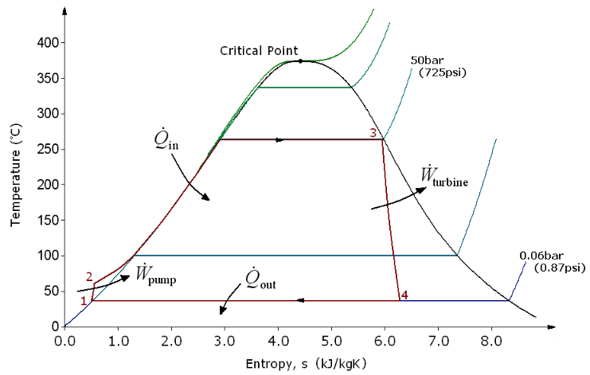
Traditional Rankine cycle
Process 1 -> 2: The working fluid is pumped from low to high pressure in the liquid state.
Process 2 -> 3: The high-pressure working fluid is heated at a constant pressure to a saturated vapor.
Process 3 -> 4: The saturated vapor expands through a turbine. Temperature and pressure decrease.
Process 4 -> 1: The wet vapor condenses into a saturated liquid at a constant pressure

Slide 15
Outline
Waste heat recovery
Sources
Recovery techniques
Technical hurdles
Thermodynamic cycles
Rankine cycle
Organic Rankine cycle
Kalina cycle
Automotive application
Special design considerations
Heat sources
Selection process
Iterative design
Cycle parameters
Design space
Mathematical modelling
Optimization
Results
Design specifications
Assumptions
Discussion
Conclusion

Slide 16
Outline
Waste heat recovery
Sources
Recovery techniques
Technical hurdles
Thermodynamic cycles
Rankine cycle
Organic Rankine cycle
Kalina cycle
Automotive application
Special design considerations
Heat sources
Selection process
Iterative design
Cycle parameters
Design space
Mathematical modelling
Optimization
Results
Design specifications
Assumptions
Discussion
Conclusion

Slide 17
Outline
Waste heat recovery
Sources
Recovery techniques
Technical hurdles
Thermodynamic cycles
Rankine cycle
Organic Rankine cycle
Kalina cycle
Automotive application
Special design considerations
Heat sources
Selection process
Iterative design
Cycle parameters
Design space
Mathematical modelling
Optimization
Results
Design specifications
Assumptions
Discussion
Conclusion

Slide 18
Outline
Waste heat recovery
Sources
Recovery techniques
Technical hurdles
Thermodynamic cycles
Rankine cycle
Organic Rankine cycle
Kalina cycle
Automotive application
Special design considerations
Heat sources
Selection process
Iterative design
Cycle parameters
Design space
Mathematical modelling
Optimization
Results
Design specifications
Assumptions
Discussion
Conclusion

Slide 19
Outline
Waste heat recovery
Sources
Recovery techniques
Technical hurdles
Thermodynamic cycles
Rankine cycle
Organic Rankine cycle
Kalina cycle
Automotive application
Special design considerations
Heat sources
Selection process
Iterative design
Cycle parameters
Design space
Mathematical modelling
Optimization
Results
Design specifications
Assumptions
Discussion
Conclusion

Slide 20
Outline
Waste heat recovery
Sources
Recovery techniques
Technical hurdles
Thermodynamic cycles
Rankine cycle
Organic Rankine cycle
Kalina cycle
Automotive application
Special design considerations
Heat sources
Selection process
Iterative design
Cycle parameters
Design space
Mathematical modelling
Optimization
Results
Design specifications
Assumptions
Discussion
Conclusion

Slide 21
Outline
Waste heat recovery
Sources
Recovery techniques
Technical hurdles
Thermodynamic cycles
Rankine cycle
Organic Rankine cycle
Kalina cycle
Automotive application
Special design considerations
Heat sources
Selection process
Iterative design
Cycle parameters
Design space
Mathematical modelling
Optimization
Results
Design specifications
Assumptions
Discussion
Conclusion

Slide 22
Outline
Waste heat recovery
Sources
Recovery techniques
Technical hurdles
Thermodynamic cycles
Rankine cycle
Organic Rankine cycle
Kalina cycle
Automotive application
Special design considerations
Heat sources
Selection process
Iterative design
Cycle parameters
Design space
Mathematical modelling
Optimization
Results
Design specifications
Assumptions
Discussion
Conclusion

Slide 23
Outline
Waste heat recovery
Sources
Recovery techniques
Technical hurdles
Thermodynamic cycles
Rankine cycle
Organic Rankine cycle
Kalina cycle
Automotive application
Special design considerations
Heat sources
Selection process
Iterative design
Cycle parameters
Design space
Mathematical modelling
Optimization
Results
Design specifications
Assumptions
Discussion
Conclusion

Slide 24
Outline
Waste heat recovery
Sources
Recovery techniques
Technical hurdles
Thermodynamic cycles
Rankine cycle
Organic Rankine cycle
Kalina cycle
Automotive application
Special design considerations
Heat sources
Selection process
Iterative design
Cycle parameters
Design space
Mathematical modelling
Optimization
Results
Design specifications
Assumptions
Discussion
Conclusion

Slide 25
Outline
Waste heat recovery
Sources
Recovery techniques
Technical hurdles
Thermodynamic cycles
Rankine cycle
Organic Rankine cycle
Kalina cycle
Automotive application
Special design considerations
Heat sources
Selection process
Iterative design
Cycle parameters
Design space
Mathematical modelling
Optimization
Results
Design specifications
Assumptions
Discussion
Conclusion

Slide 26
Outline
Waste heat recovery
Sources
Recovery techniques
Technical hurdles
Thermodynamic cycles
Rankine cycle
Organic Rankine cycle
Kalina cycle
Automotive application
Special design considerations
Heat sources
Selection process
Iterative design
Cycle parameters
Design space
Mathematical modelling
Optimization
Results
Design specifications
Assumptions
Discussion
Conclusion

Slide 27
Outline
Waste heat recovery
Sources
Recovery techniques
Technical hurdles
Thermodynamic cycles
Rankine cycle
Organic Rankine cycle
Kalina cycle
Automotive application
Special design considerations
Heat sources
Selection process
Iterative design
Cycle parameters
Design space
Mathematical modelling
Optimization
Results
Design specifications
Assumptions
Discussion
Conclusion

